Slide 1

Understanding the World with F#
Tomas Petricek
tomas@tomasp.net | @tomaspetricek
PhD Student at University of Cambridge
& Coordinator of http://fsharp.org

Slide 2

All the Data of the World

Slide 3
data acquisition statistics data cleaning machine learning data transformation visualization type providers
F# Data Science Working Group
kaggle vega grammar data sources presentation
R provider visualization
www.fslab.org
time-series data aggregation

Slide 4
Acquire
Analyze
Visualize

Slide 5

Demo: Analyzing Titanic survivors

Slide 6


Deedle data frame
Data exploration
Indexing and aggregation
F# Charting library
Simple & composable
Interactive style
www.fslab.org

Slide 7
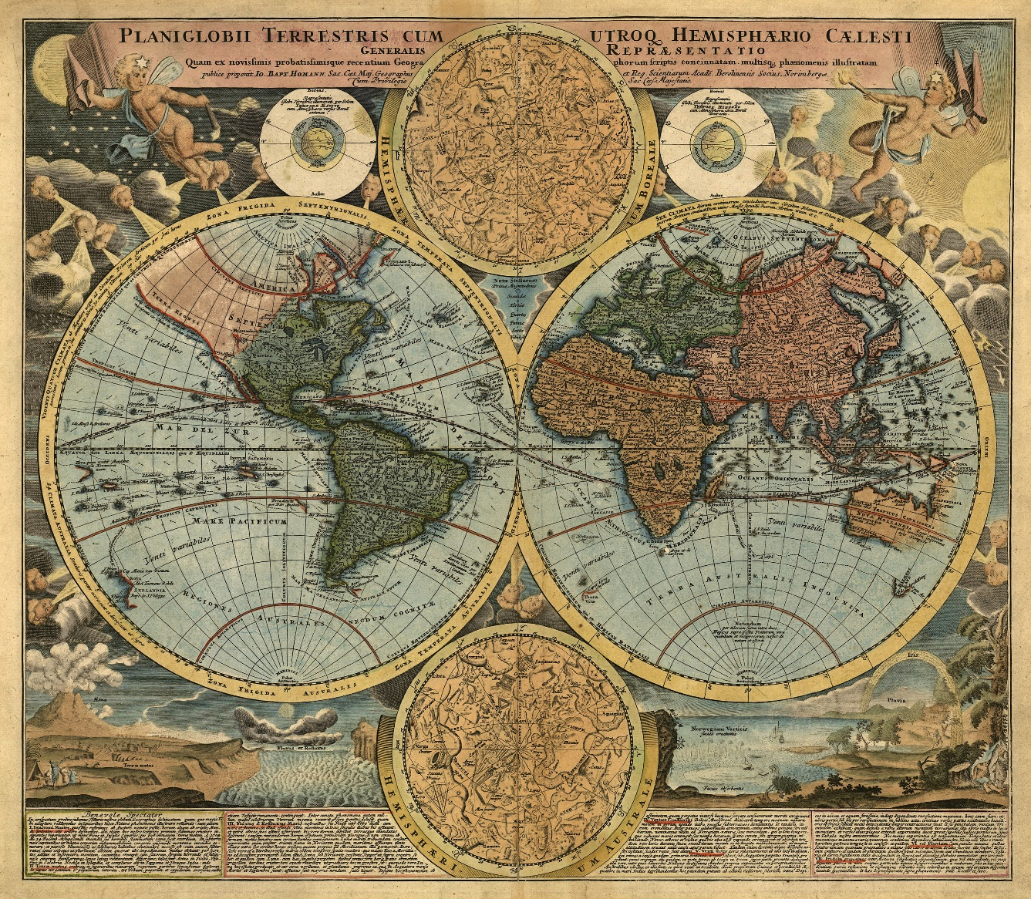
Demo: Understanding the world

Slide 8


F# Data type providers
First-class data
CSV, REST, WorldBank…
R Type provider
Statistics & visualization
5000 tested packages
www.fslab.org

Slide 9
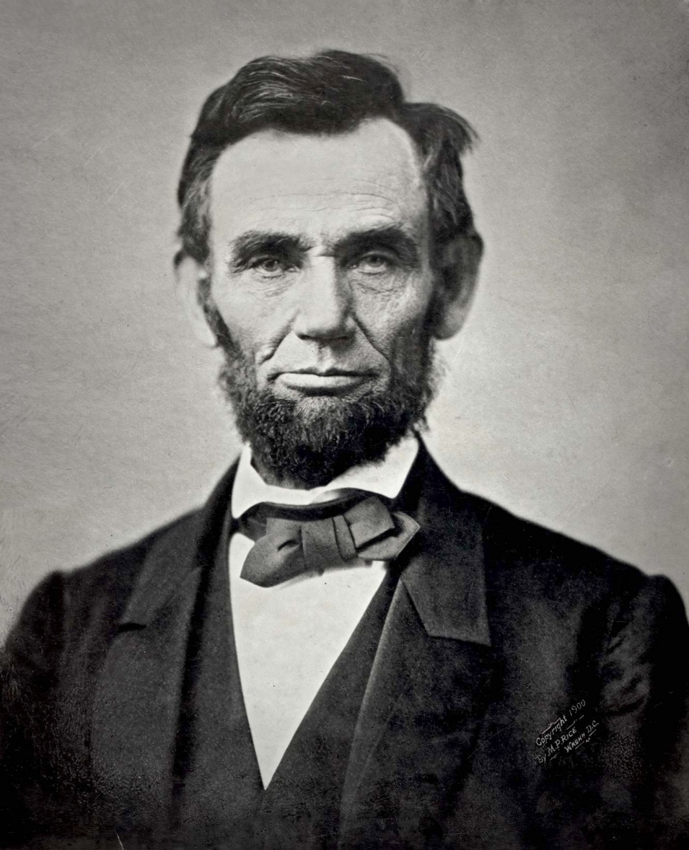
Demo: US debt over the last century

Slide 10

Deedle data frame
Time-series alignment
Data transformations
Vega visualization
F# wrapper for Vega
Pre-alpha version
www.fslab.org

Slide 11
F# for Data Science
acquire, analyze, visualize
interactive experience
safety and efficiency of .net
ready for production

Slide 12
F# Data Science working group
Help us build a better stack!
http://fsharp.org/technical-groups

Slide 13
software stacks trainings teaching F# user groups snippets mac and linux community books and tutorials
F# Software Foundation
consulting open-source MonoDevelop
http://www.fsharp.org
contributions research support cross-platform mailing lists

